Slide 1
MLSA Internship Full Stack Web Development
Name – SAJAL MITTAL
Branch – CS
Roll no – 2200290120141
Year - 3

Slide 2
Introduction Of Internship
This internship provides a solid foundation in full stack development concepts and tools.
It offers hands-on experience through real-world projects, enhancing practical skills.
Throughout this journey, I’ve gained knowledge of various technologies and tools, including GitHub and more.

Slide 3
Project 1 : To Do Web App (EASY)
The project is a web application designed to offer users an intuitive, user-friendly interface.
Users can add and delete tasks based on their needs, enhancing task management convenience.
Html, CSS, Javascript are the technologies used in this project.
Core JavaScript concepts such as event handling with EventListener, DOM manipulation, and loops are utilized to create a seamless user experience.

Slide 4
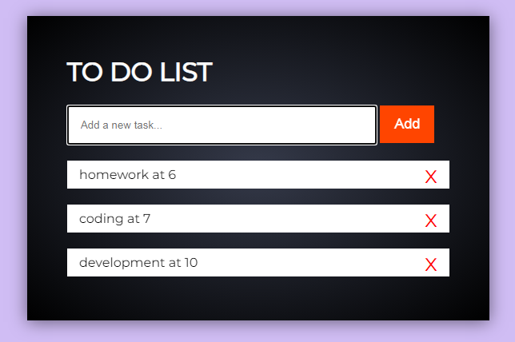
User Interface

Slide 5
Technologies Used
Structure: HTML provides the foundational structure for the web app.
Styling: CSS is utilized to design and style the visual aspects.
Functionality: JavaScript enables interactivity, allowing buttons and other elements to perform actions on click.

Slide 6
Project 2 : Basic Calculator (Intermediate)
A web app that performs basic calculations based on user input.
It’s a practical, real-time project that provides instant results.
JavaScript functions handle the operations and return accurate calculations immediately.
The project focuses on creating a simple, user-friendly interface for easy interaction.

Slide 7
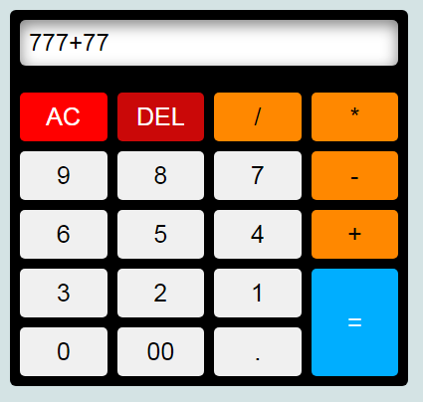
User Interface

Slide 8
Technologies Used
HTML: Defines the structure of the calculator, including buttons and display screens.
CSS: Styles the layout and appearance, making the calculator visually appealing and easy to navigate.
JavaScript: Implements the calculator's core functionality, enabling arithmetic operations and responsive button interactions.

Slide 9
Conclusion
Provides essential, hands-on experience through project-based learning.
Offers strong mentorship support for resolving any doubts.
Enables skill development in full-stack development, with opportunities to learn and apply new technologies.

